Slide 1
X-Track
Presented by: Shobhit Pandey
Course: BCA 5th Semester
Year: 2025-26
Institution: Centre of Computer Education & Training
Institute of Professional Studies University of Allahabad
Prayagraj Uttar Pradesh

Slide 2
Objective of the Project
• The aim of the "Expense Tracker" is to empower its target users with enhanced financial visibility and control.
• Provide functionality for predefined and custom expense categories, allowing users to efficiently classify their spending.
Anticipated Benefits
The successful deployment of the "Expense Tracker" is expected to deliver benefits to its users:
• Enhanced Financial Awareness
• Improved Budget Adherence
• Increased Savings Potential
• Reduced Financial Stress
• Simplicity and Accessibility

Slide 3
Goal of the Project
To develop a cross-platform expense management system.
To ensure real-time synchronization between frontend and backend.
To enable data storage, retrieval, and analytics seamlessly.
To enhance financial awareness and encourage better budgeting habits among users.

Slide 4
Problem Definition
The main problem addressed by this project starts from the problems that middle-class individuals and competitive exam aspirants face in maintaining a record of their everyday financial transactions.
Without a clear view of where their money goes, it becomes challenging to:
• Identify unnecessary spending areas.
• Follow the declared budgets.
• Collect savings for future goals (e.g., higher education, home purchase, emergency fund).
• Understand the impact of small, seemingly unused expenditures.
Existing accounting software often becomes too complex or expensive for this work, while basic mobile notes or calculator apps lack the capabilities required for genuine financial details.

Slide 5
Layout of the Project
Frontend (KivyMD): Handles user interface and data input on the mobile app.
Backend (Django): Processes user requests, connects to database, manages APIs.
Database (MySQL): Stores user information and expense details.
Architecture Layout:
[ User Interface (KivyMD) ] ↓ [ Django Backend / REST API ] ↓ [ MySQL Database ]

Slide 6
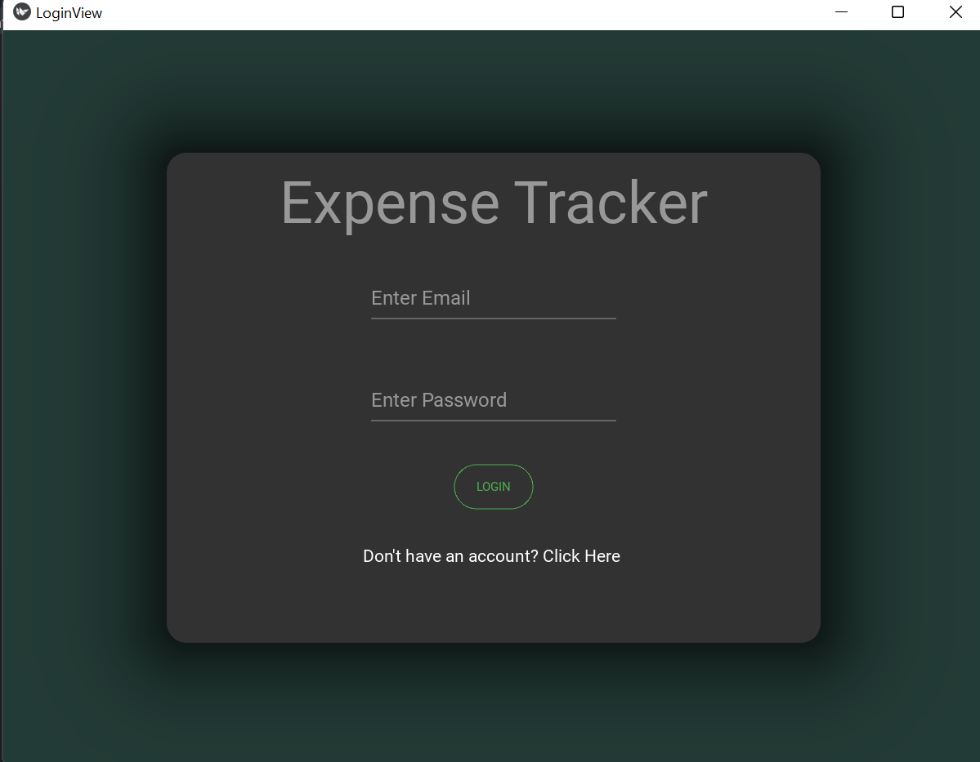
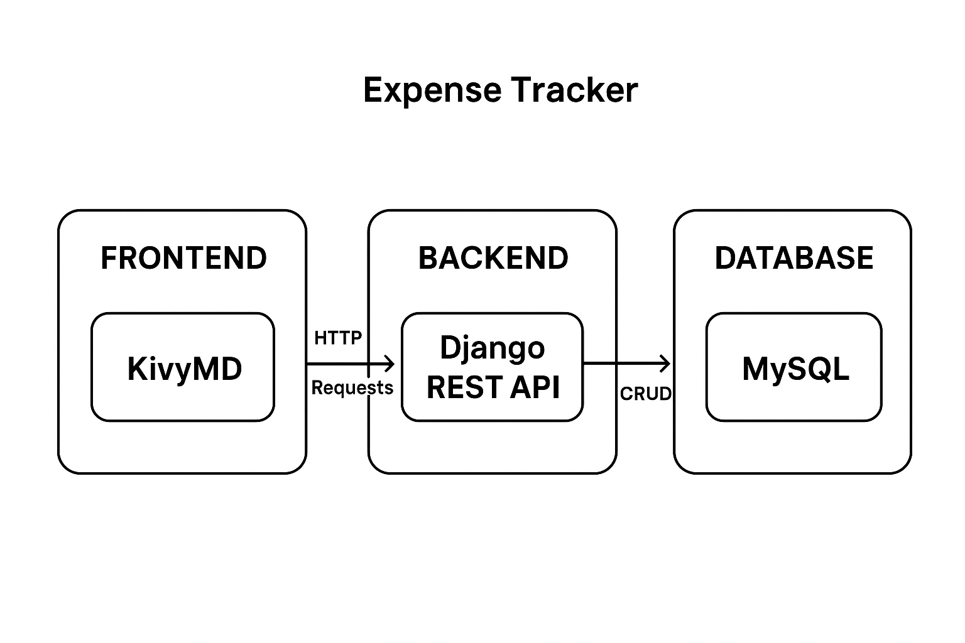
Screenshots

Slide 7
THANK YOU !

